Slide 1
Numerical modelling of dark atom interaction with nuclei.
T.E. Bikbaev, M.Yu. Khlopov, A.G. Mayorov
Presented at XXIV Bled Workshop
“What comes beyond the Standard models?”

Slide 2
The problem of the dark matter.
2

Slide 3
Scenarios of hypothetical, stable, electrically charged particles.
In this paper, we consider the scenario of composite dark matter, in which hypothetical stable particles $О^{−−}$(X) avoid experimental discovery, because they form neutral atom-like states OHe (X-helium) with primary helium, called "dark" atoms.
M.Yu.Khlopov. Dark atom solution for puzzles of direct dark matter searches. IOP Conf. Series: Journal of Physics: Conf. Series 1312 (2019) 012011; doi:10.1088/1742-6596/1312/1/012011
M.Yu.Khlopov. Cosmoparticle physics of dark matter. EPJ Web of Conferences V. 222, 01006 (2019) Proceedings of QFTHEP2019. E-Print: arXiv:1910.12910; https://doi.org/10.1051/epjconf/201922201006
M.Yu.Khlopov. Removing the conspiracy of BSM physics and BSM cosmology. International Journal of Modern Physics D Vol. 28 (2019) 1941012 (16 pages); DOI: 10.1142/S0218271819410128
M.Yu.Khlopov Conspiracy of BSM physics and cosmology. Bled Workshops in Physics, V.20 PP.21-35 (2019) e-Print: arXiv:1911.03294.
3
Illustration of the “dark” OHe atom and the outer core of substance A

Slide 4
XHe model and solution to the problem of direct searches for dark matter particles.
The XHe model assumes the existence of relict, stable, lepton-like, massive (~ TeV) particles with a charge of -2n, bound by the Coulomb interaction with primordial helium nuclei into "dark atoms" of dark matter.
The results of the DAMA / NaI and DAMA / LIBRA experiments can be explained by annual modulations of energy release during the formation of the low-energy bound state of XHe with nuclei.
4

Slide 5
The existence of a low-energy bound state of XHe with nuclei and the dominance of elastic processes in the XHe scenario are based on the hypothesis of the presence of a dipole potential barrier in the interaction of XHe with nuclei, which requires a correct quantum-mechanical description.
5
The effective interaction potential between XHe and nucleus

Slide 6
Bohr's model of the atom.
The density of the distribution of the coordinates of the α-particle in the orbit corresponding to the ground state of the system
6

Slide 7
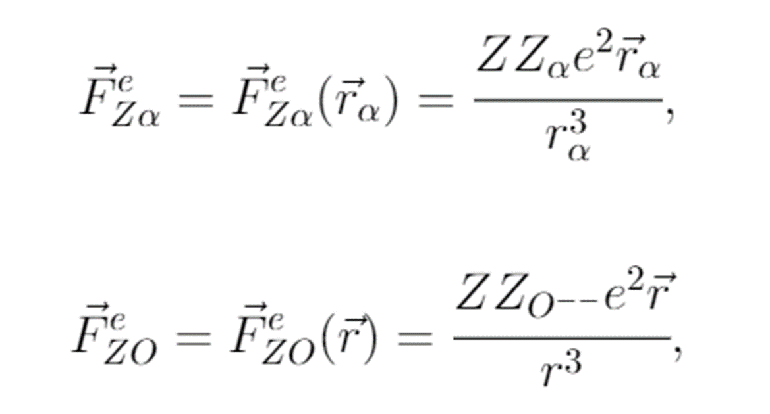
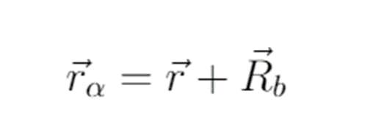
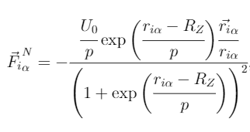
OHe – nucleus coordinate system.
7

Slide 8
The trajectory of the alpha-particle and the particle $O^{−−}$ in the XY plane
8

Slide 9
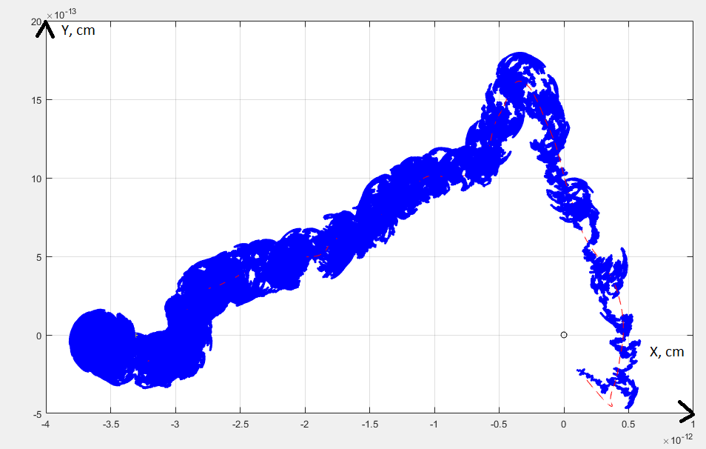
Stark effect.
9
The trajectory of the alpha-particle and the particle $O^{−−}$ in the XY plane

Slide 10
Total potential of interaction between He and the target nucleus
10

Slide 11
Total potential of interaction between He and the target nucleus
11

Slide 12
Thomson's model of the atom. MODELING OF X-HELIUM.
Potential of the Coulomb interaction and the corresponding force between n-helium and X
12

Slide 13
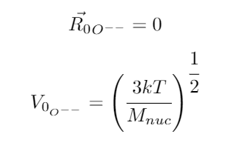
System XНе (origin at the center of nНе).
X particle trajectory
13

Slide 14
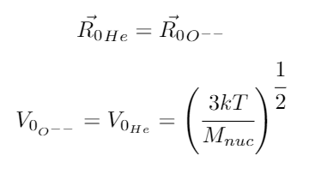
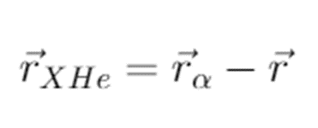
XHе-nucleus system.
Graph of r versus rα
14

Slide 15
Graph of r versus rα
15

Slide 16
Total potential of interaction of nHe with the nucleus depending on the distance between the nucleus and nHe
16

Slide 17
Change in the Coulomb potential of interaction of nHe and X with the target nucleus.
17
Trajectories of motion of nHe and X particle in the XY plane

Slide 18
Total potential of interaction of nHe with the nucleus depending on the distance between the nucleus and nHe
18

Slide 19
Non-zero impact parameter.
Trajectories of motion nHe and X particle
19

Slide 20
Total potential of interaction of nHe with the nucleus depending on the distance between the nucleus and nHe
20

Slide 21
Results of the Bohr Atom Model
When simulating in the Bohr atom approximation, the following effects were observed: The trajectory of the $О^{−−}$ particle deviates from the initial direction due to the action of the Coulomb force between the α-particle and the target nucleus, and the $О^{−−}$ trajectory experiences beats in the vicinity of the nucleus due to the action of the nuclear interactions between the alpha particle and the target nucleus. In this case, elastic interaction prevails. The artificially introduced Stark effect has a strong influence on the trajectories of particle motion. This is reflected in the form of rather diverse results of interaction between particles, which can be seen from the construction of the total interaction potentials. And it requires a detailed study in the form of an analysis of the trajectories of motion when the initial values of coordinates and velocities and parameters of the target nucleus are varied.
21

Slide 22
Results of the Thomson Atom Model
When simulating in the Thomson atom approximation, the following effects were observed: When the impact parameter is zero, the XHe atom flies through the target nucleus, then comes back and flies in the opposite direction. With a nonzero impact parameter, the XHe atom hits the target nucleus, and a certain oscillatory system of three bodies is formed. This is what is expected to be seen in the formation of a low-energy bound state in the interaction of slow X-helium atoms with the nuclei of matter. However, the disadvantage of this is that particle oscillations occur inside the target nucleus. Thus, in the current version of the numerical model, nHe can easily penetrate into the target nucleus and the elastic collision of nuclei is not taken into account. In the Thomson approximation, helium is always inside the nucleus; elastic scattering is not observed. In the approach of the Bohr atom, the opposite was true. Therefore, in the future, it should be taken into account that nuclear matter is incompressible, opaque, and mutual penetration of nHe and the nucleus is impossible. In other words, we need to take into account the real properties of nuclear matter.
22

